Slide 1



Slide 2
Instructions on how to express colostrum before delivery Jennifer Heitkamp, BSN, RN, International Board-Certified Lactation Consultant Wayne HealthCare
Notes:
My name is Jennifer, and I am a registered nurse (RN) and an international board-certified lactation consultant (IBCLC) in the labor and delivery unit at Wayne Healthcare in Greenville, Ohio. I have been a registered nurse for 33 years, and a lactation consultant for over two years. This presentation aims to educate you on expressing colostrum before delivery, how to properly store the colostrum, and the benefits it can provide to your newborn.

Slide 3
Objectives
After viewing this PowerPoint, participants will be able to:
1) Verbalize the Academy of Breastfeeding Medicine recommendations for exclusive breastfeeding, and what it means to breastfeed exclusively.
2) Identify the benefits of breastfeeding.
3) Identify the benefits of antepartum expression of colostrum.
4) Verbalize how to express colostrum before delivery
5) Verbalize how to store colostrum before delivery.
Notes:
After viewing this PowerPoint, participants will be able to:
1) Verbalize the Academy of Breastfeeding Medicine recommendations for exclusive breastfeeding.
2) Identify the benefits of breastfeeding.
3) Verbalize how to express colostrum before delivery
3) Verbalize how to store colostrum before delivery.

Slide 4
American Academy of Pediatrics Statement:
Exclusively breastfeed for the first 6 months and continue breastfeeding for one full year. Continue as long as mutually desired by the mother and the child.
(Meek & Noble, 2025)
Notes:
According to Meek and Noble (2025), exclusively breastfeed for the first 6 months and continue breastfeeding for one full year. Continue as long as mutually desired by the mother and the child. These recommendations are consistent with guidelines from the World Health Organization (WHO), the American College of Obstetricians and Gynecologists (ACOG), and the American Academy of Family Physicians (AAFP) (Meek & Noble, 2025).

Slide 5



What is exclusive breastfeeding?
An infant's consumption of human milk by direct breastfeeding or an alternative method with no supplementation of any type.
This includes: no formula, cow’s milk, juice, sugar water, or baby food.
( Ohio Department of Health, 2024)
Notes:
According to the Ohio Department of Health ( 2024), exclusive breastfeeding: An infant's consumption of human milk by direct breastfeeding or alternative method with no supplementation of any type (including infant formula, cow's milk, juice, sugar water, baby food and anything else, even water)

Slide 6

Benefits of breastfeeding
Best source of nutrition for babies
Mother’s milk changes to meet the nutritional needs of the baby
Protects babies against illnesses and diseases
Stronger immune systems
( CDC, 2025)
Notes:
According to the Centers for Disease Control and Prevention ( CDC, 2025), breastmilk is the best source of nutrition for babies. Mother's milk will actually change according to the baby's needs at that time. Breast milk helps protect the baby against illnesses and diseases and aids in building a stronger immune system. ( CDC, 2025).

Slide 7

Benefits of breastfeeding
Lower risk of:
Asthma
Obesity
Type 1 diabetes
Sudden Infant Death Syndrome (SIDS)
Fewer ear infections
( CDC, 2025)
Notes:
There are many benefits of breastfeeding, and according to the Centers for Disease Control and Prevention ( CDC), babies who are breastfed have a lower risk of asthma, obesity, type 1 diabetes, sudden infant death syndrome ( SIDS), and have fewer ear infections ( CDC, 2025). Breastfeeding also increase the babies immune system to help protect them for various illnesses ( CDC, 2024).

Slide 8

Benefits of collecting colostrum before delivery for the mother
Mothers felt they developed the skill and mindset to breastfeed.
Confidence in the ability to breastfeed & produce milk postpartum.
Increase onset of milk supply post birth.
Sense of satisfaction that they build a supply of milk ahead of time.
(Demirci et al., 2019).
Notes:
There are numerous benefits to collecting colostrum before delivery for both you and your baby. Mothers who expressed colostrum before the delivery felt they had developed the skills and mindset to breastfeed. It gave them confidence in their ability to breastfeed and produce milk. It has also been shown to increase the onset of your milk supply after delivery in some cases. Many women felt a sense of satisfaction in having built a supply of milk ahead of time, which also boosted their confidence.
According to Demirci et al. (2019), women who received education on how to collect colostrum during the antenatal period felt more confident after delivery. They stated that they felt confident they could produce enough breast milk for their newborns after delivery. If mothers feel they are making enough breastmilk for their newborns, they will be less likely to request formula supplementation. According to Demirci et al. (2025), women who expressed before delivery experienced an increase in the onset of their milk supply post birth.
This study also showed that women found antenatal milk expression provided them with the motivation necessary to prepare for the physical and psychological challenges of breastfeeding before delivery (Demirci et al., 2019).
Lastly, prenatal interventions are an essential part of breastfeeding support programs, and clinicians should discuss the benefits of breastfeeding during the prenatal period (Jack et al., 2024).

Slide 9

Benefits of collecting colostrum before delivery for baby
Reduces formula use in breastfed infants.
Some babies experience difficulties with feeding and need an extra “boost” until milk supply increases.
Some babies need supplementation due to low blood sugar levels the first couple of days.
Some women have a delay in their “ milk coming in” so it can be used to supplement baby until mothers supply increases.
(Association of Breastfeeding Mothers, 2023)
Notes:
There are many benefits for the baby to have a small supply of colostrum ready after delivery. In many cases, having a supply of colostrum before delivery can reduce the need for formula in breastfed infants (Association of Breastfeeding Mothers, 2023). Some babies experience difficulties with feeding and need an extra” boost” until milk supply increases. (Some examples may be a sleepy baby, a baby with a tongue tie, or a baby that is still learning to breastfeed and needs a little more time to practice.
Some babies require supplementation due to low blood sugar levels for the first few days. (Association of Breastfeeding Mothers, 2023).
Some women have a delay in their “ milk coming in,” so it can be used to supplement the baby until the mother's supply increases.

Slide 10
When can I start expressing colostrum?
.
The providers at Wayne HealthCare recommend waiting until 38 weeks of gestation or more before expressing colostrum before delivery.
Please discuss any concerns with your OB provider
(Meek & Noble, 2025)
Notes:
The providers at Wayne HealthCare recommend waiting until 38 weeks of gestation or more before expressing colostrum before delivery.
Please discuss any concerns with your OB provider.

Slide 11
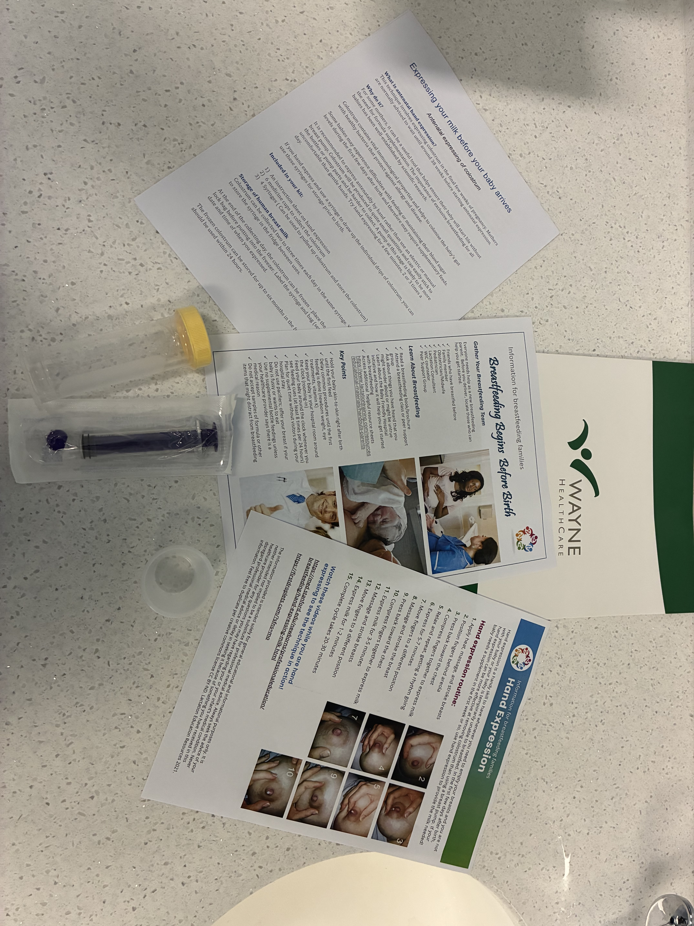
( Lactation Education Resources, 2025) ( Raju, 2023)
Centers for Disease Control and Prevention,2025).
( Association of Breastfeeding Mothers, 2025).
Notes:
Included in this kit are informational sheets from Lactation Education Resources ( Lactation Education Resources, 2025), Also included are some medicine cups that they can use for collecting drops of colostrum, a sterile syringe, and a sterile container in which you can store the breastmilk ( Centers for Disease Control and Prevention, 2025). I also included my business card so you can get in touch with me if you have any questions.

Slide 12
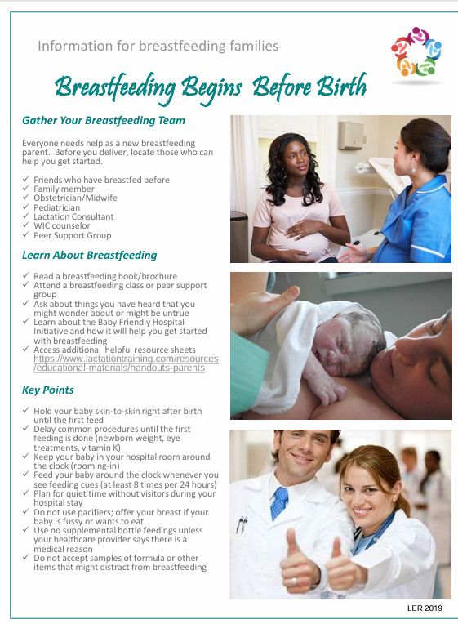
Information Resources
( Lactation Education Resources, 2025)
Notes:
In your folder, you will find an informational sheet titled “ Breastfeeding Begins Before Birth.” This informational sheet contains information on how to prepare for breastfeeding before you give birth. (Lactation Education Resources, 2025). It is essential to learn as much as possible before delivery. You can sign up for a breastfeeding class at Wayne HealthCare, read a breastfeeding book, or talk to a healthcare provider who is knowledgeable about breastfeeding. You may contact me at Wayne Healthcare at any point before, during, or after you give birth. I will be more than happy to answer any questions you may have.

Slide 13
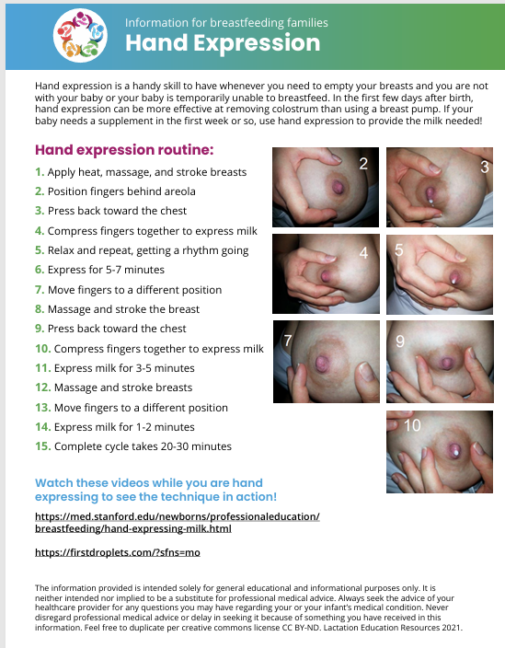
Information Resources
( Lactation Education Resources, 2025)
Notes:
The next educational sheet provided in your folder is titled “ Hand Expression”. This informational sheet outlines the steps to hand expression. This also includes a link to a video made by Stanford University that the mothers can view if you wish ( Lactation Education Resources, 2025).
Women have found that they can express colostrum more effectively by hand expression. You can follow this guide and express drops of colostrum into the medicine cup provided. After you are done expressing, you can collect the colostrum with the provided syringe.

Slide 14
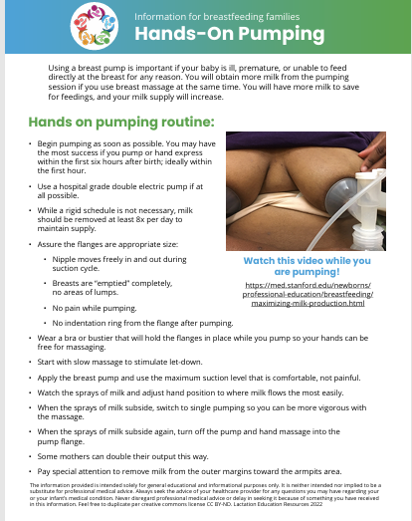
Information Resources
( Lactation Education Resources, 2025)
Notes:
The next educational sheet provided in your folder is titled “ Hands on Pumping”. This informational sheet outlines the steps for hands-on pumping using a breast pump. This also includes a link to a video made by Stanford University that the mothers can view if you wish ( Lactation Education Resources, 2025). Some women are more comfortable, or have better luck expressing colostrum with either a hand pump or an electric pump. Whatever you chose to use is totally up to you.

Slide 15
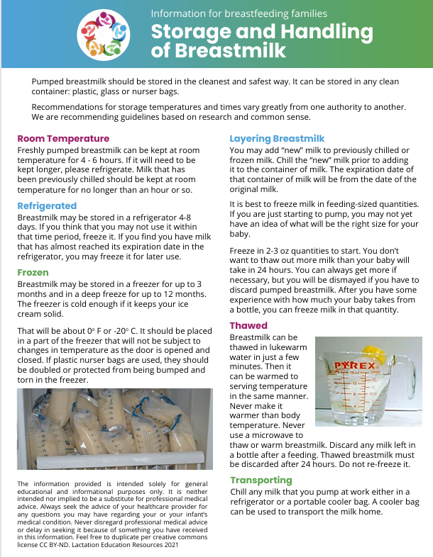
Information Resources
( Lactation Education Resources, 2025)
Notes:
The toolkit includes an educational sheet from Lactation Education Resource titled “ Storage and Handling of Breastmilk.” This handout details how pumped breastmilk should be stored. It includes how long breastmilk is good for at room temperature, in the refrigerator, and in the freezer. It explains what types of storage containers are safe to use and the proper ways to thaw it. It also discusses how to transport breast milk safely (Lactation Education Resources, 2025). Please review this informational sheet and follow the guidelines for the safe storage and handling of your breast milk.

Slide 16
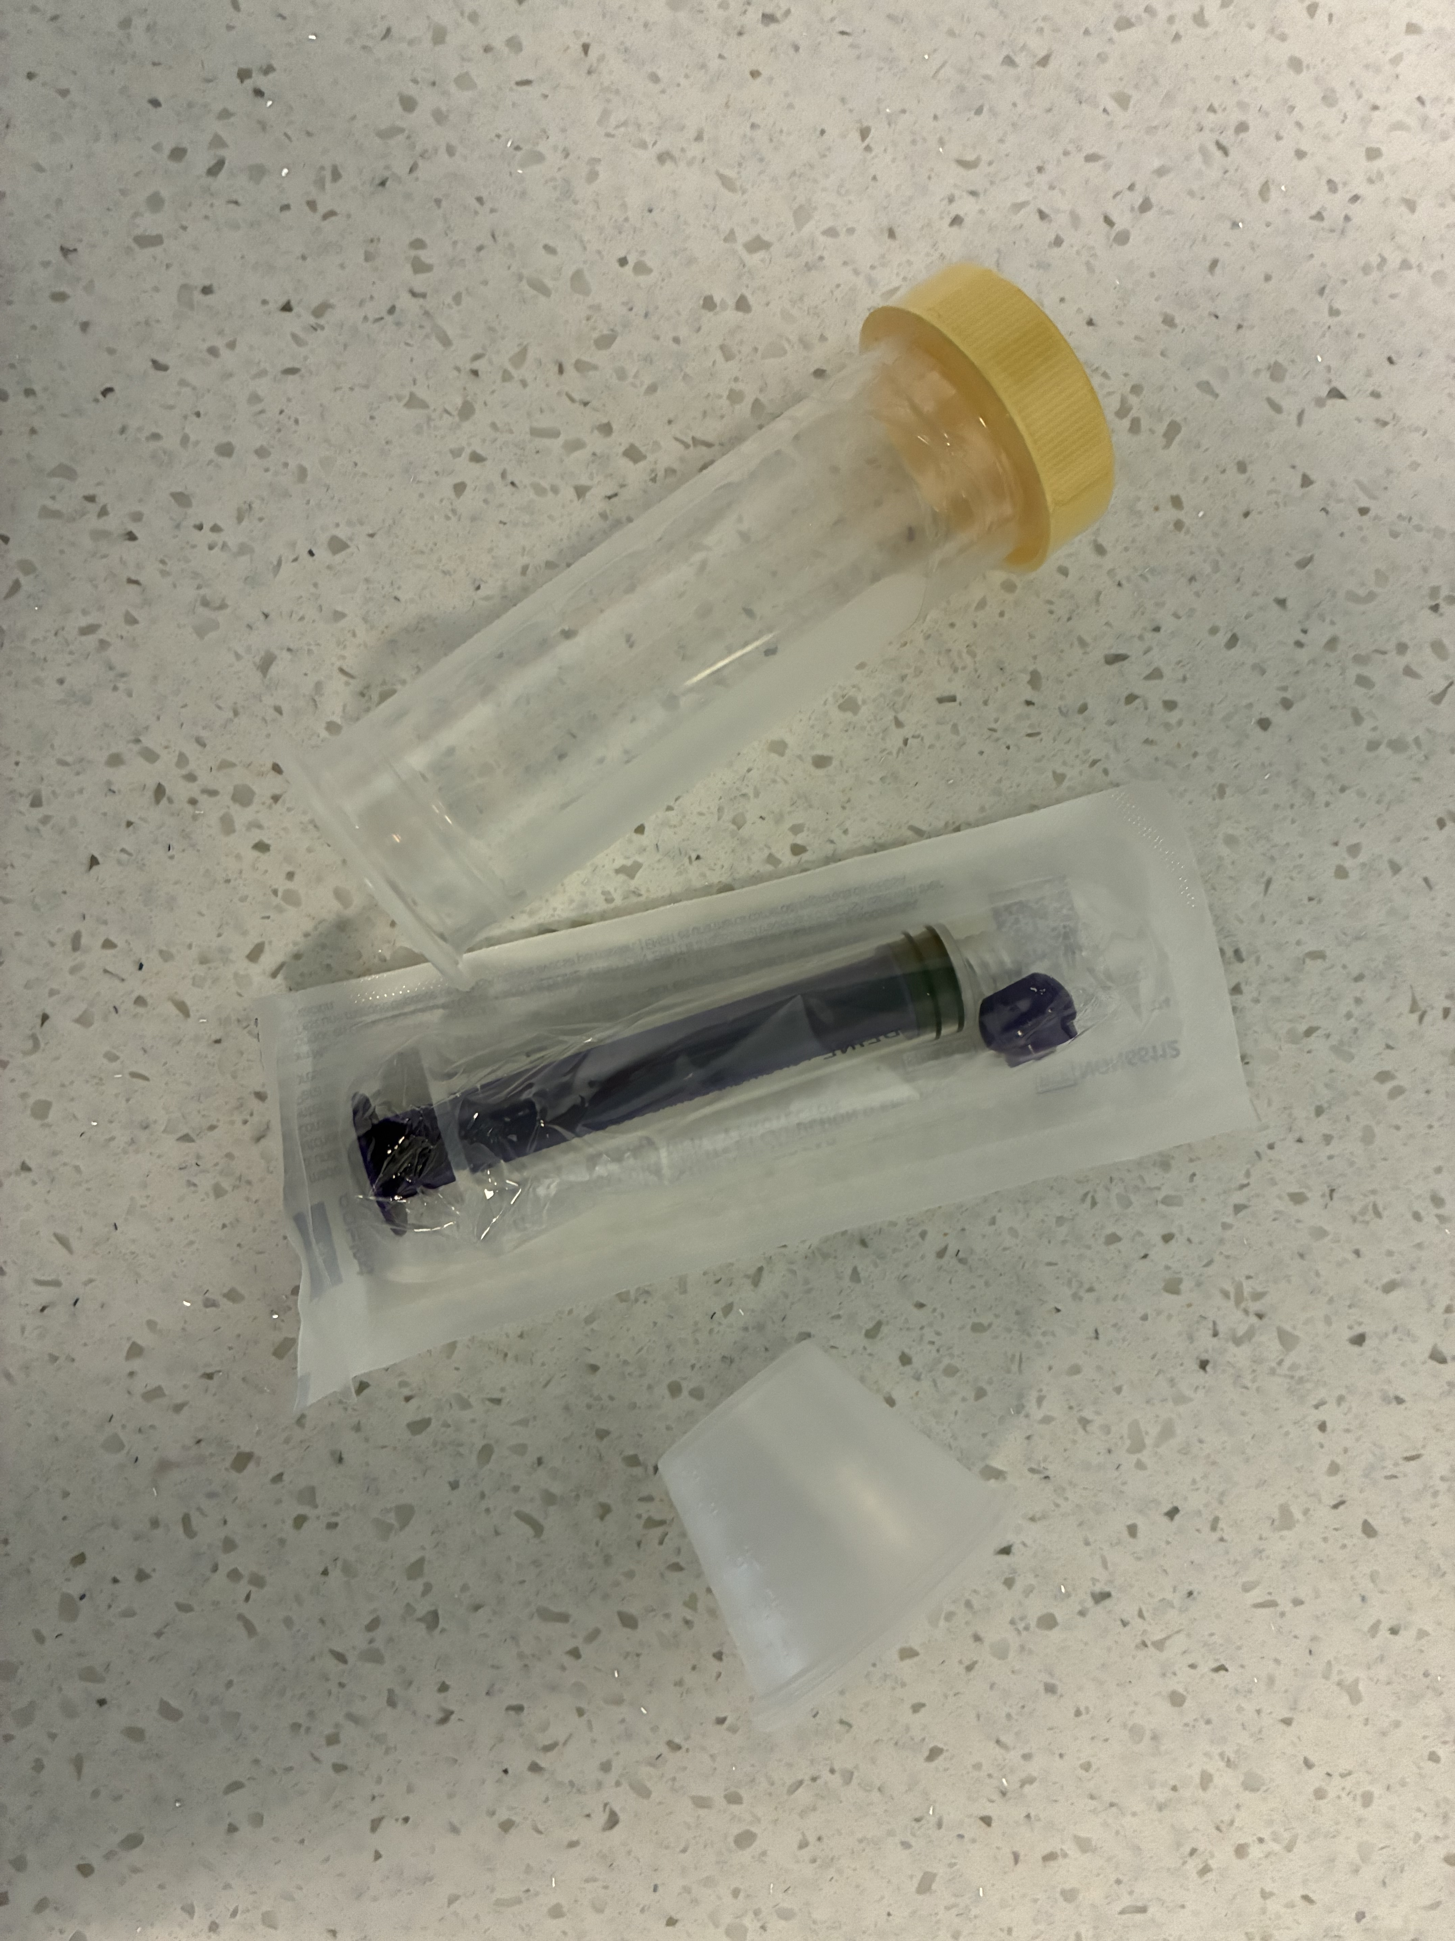
Supplies needed to initiate expression
(Larobina et al., 2024)
Notes:
Included in your kit are 5 mL sterile syringes with caps, medicine cups, and a 3-oz sterile Medela bottle. The containers do not have to be sterile, but I wanted to ensure the cleanest and safest means possible, so I chose to include the sterile containers.
You may use the medicine cup for hand expression if you choose to hand express. Whatever drops of colostrum you get, you may pull them up into the syringe. The syringe can be kept in the refrigerator between collection times and more drops can be slowly added to the syringe. Some women may only get a few drops of colostrum at a time, but that is ok. Every drop can be saved. Even if you only get 1 or 2 mL’s total, that may be all that is needed just in case your baby needs supplemented after delivery for whatever reason.
According to Larobina et al. ( 2024), evidence shows no significant differences in the nutritional and immunological properties or bacterial contamination of EBM stored in the three container types. The guidelines recommend the use of either plastic bags, or storage containers made of plastic or glass. Plastic containers were probably slightly preferable to glass bottles due to the adherence of immune cells to glass. Evidence showed that each container type had different practical advantages and minimal influence on milk quality; hence, any container was suitable.
You may chose to put your colostrum in a storage bag that is made for breast milk as well.

Slide 17
Storage of breastmilk
Store in clean container: Plastic, glass or breastmilk storage bags
Room Temperature | Refrigerated | Freezer | Deep freezer
4-6 hours | 4-8 days | 3 months | 12 months
 | Freeze if not able to use within time frame | Place in deep freezer if unable to use within time frame
(Larobina et al., 2024
Notes:
Freshly expressed breast milk may be stored at room temperature for 4-6 hours. If you are not going to use it within that time frame, place it in the refrigerator for between 4-8 days. If you are not going to use refrigerated breastmilk within that time frame, place it in a regular freezer for up to 3 months or in a deep freezer for up to one full year (Lactation Education Resources, 2025).

Slide 18
Layering breastmilk
Layering breastmilk:
It is recommended to chill freshly expressed milk before adding it to already chilled breastmilk.
Place refrigerated breastmilk in the freezer if you are uncertain when you are going to use it.
( Lactation Education Resources, 2025)
Notes:
Layering breastmilk:
It is recommended to chill freshly expressed milk before adding it to already chilled breastmilk.
Place refrigerated breastmilk in the freezer if you are uncertain when you are going to use it.

Slide 19
Label container
Transporting
Please label your colostrum containers with your full name & date.
If you are bringing it to the hospital, also place it in a freezer bag and label the bag with your full name & date.
If you decide to bring your expressed breastmilk to the hospital, please keep it frozen during transportation. You can use a cooler with ice packs for this
Sally Jones
Collected on 10/20/2025
( Lactation Education Resources, 2025)

Slide 20

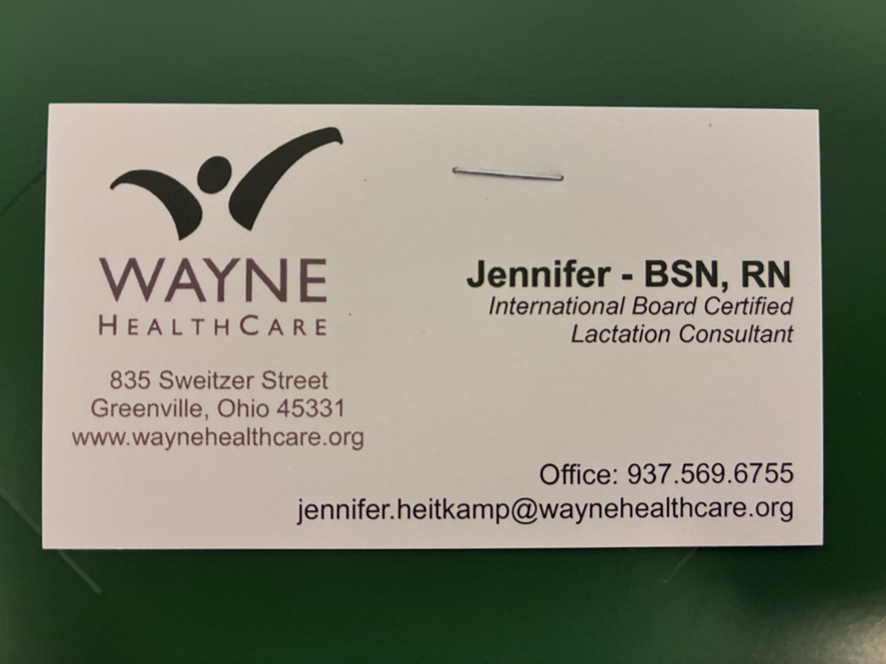
Business card
( Raju, 2022).
Notes:
Also included in your kit is my business card. I have included my lactation office phone number and email address for your convenience. You can contact me by phone or email at any time, either before delivery or after. I will be happy to assist you in any way I can.
Note: According to Raju (2022), a survey identified several specific factors that can affect breastfeeding continuation in the United States. One of these factors included the lack of availability of lactation consultants, especially in rural areas. Wayne HealthCare is located in a rural area, so we have very few lactation consults. The lack of support from lactation consultants has been shown to reduce the rate of exclusive breastfeeding ( Raju, 2022). For this reason, it was essential to include my business card in every toolkit. My business card contains information about how to reach me via phone or email.

Slide 21
Association of Breastfeeding Mothers. ( 2023). Expressing your milk before your baby arrives: Antenatal expressing of colostrum. https://abm.me.uk/breastfeeding-information/antenatal-expression-colostrum/#:~:text=Some%20tips%20for%20hand%20expressing%20colostrum%20include:,freeze%20it%20for%20up%20to%20six%20months.
Centers for Disease Control and Prevention. (2025, May 16). Breast milk storage and preparation. https://www.cdc.gov/breastfeeding/breast-milk-preparation-and-storage/handling-breastmilk.html
Demirci, J. R., Glasser, M., Fichner, J., Caplan, E., & Himes, K. P. (2019). "It gave me so much confidence": First-time U.S. mothers' experiences with antenatal milk expression. Maternal & child nutrition, 15(4), e12824. https://doi.org/10.1111/mcn.12824
References

Slide 22
References
Lactation Education Resources. ( 2025). Professional lactation handouts. https://www.lactationtraining.com/resources/handouts-professionals
Larobina, C., Muller ,A., Templeton, I., & Sweet, L. (2024). Community practices, published guidelines, and evidence-based surrounding breast milk handling and storage: A qualitative study. Breastfeeding Medicine, 19(3), 1-11. https://pubmed.ncbi.nlm.nih.gov/38386986/
Meek, J. Y., Noble, L. (2022). Policy statement: Breastfeeding and the use of human milk. Pediatrics, 150(1), e2022057988. https://doi.org/10.1542/peds.2022-057988
Ohio Department of Health[ODH]. (2024). Infant feeding domain. https://odh.ohio.gov/wps/wcm/connect/gov/651bdd34-95bc-4d1b-bee9-17f8154ae39a/ODH+Infant+Feeding+Directive.pdf?MOD=AJPERES&CONVERT_TO=url&CACHEID=ROOTWORKSPACE.Z18_M1HGGIK0N0JO00QO9DDDDM3000-651bdd34-95bc-4d1b-bee9-17f8154ae39a-p8uO38Y
Raju T. N. K. (2023). Achieving healthy people 2030 breastfeeding targets in the United States: challenges and opportunities. Journal of Perinatology: Official Journal of the California Perinatal Association, 43(1), 74–80. https://doi.org/10.1038/s41372-022-01535-x

